Slide 1
MiniMax Algorithm with Alpha-Beta Pruning
function MINIMAX-AB(N, Depth, Alpha, Beta)
begin
if leaf(N) or Depth = 0 then
return Estimate(N)
if N is a Min node then
For each successor Ni of N
Beta = min{Beta, MINIMAX-AB(Ni, Depth-1, Alpha, Beta)}
if Alpha >= Beta then
return Beta //Prune
end for
return beta
else //Max node
For each successor Ni of N
Alpha = max{Alpha, MINIMAX-AB(Ni, Depth-1, Alpha, Beta)}
if Alpha >= Beta then
return Alpha //Prune
end for
return alpha
end if
Notes:
Checkout:
http://will.thimbleby.net/algorithms/doku.php?id=minimax_search_with_alpha-beta_pruning
For an animated walk through.

Slide 2
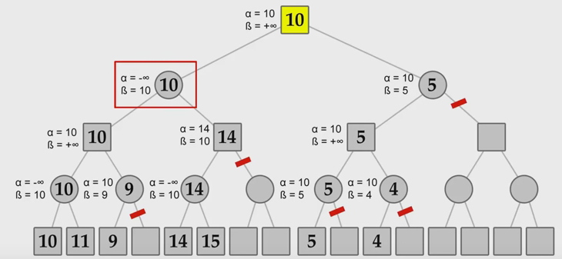
Solution

